Slide 1

Welcome

Slide 2
Business Analytics
Class – 12

Slide 3
Quick Recap
Python Basics/Pandas/ Statistics
Data Visualization Modelling Overview
Linear Regression
Decision Tree Classifier/Regressor
Application of Analytics
Churn Analytics
Time Series
Social Media Analytics

Slide 4
What we will do today
Git & Github
Presenting our work

Slide 5

That’s it

Slide 6
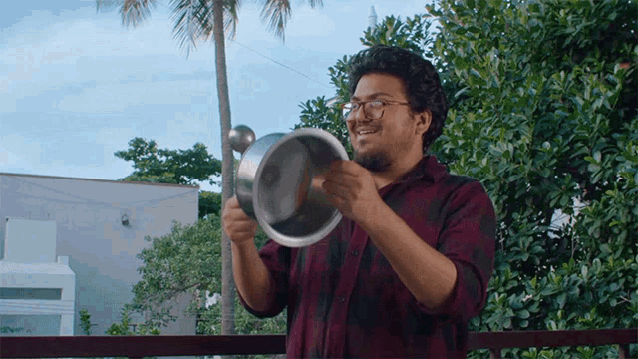
Let’s go !!

Slide 7
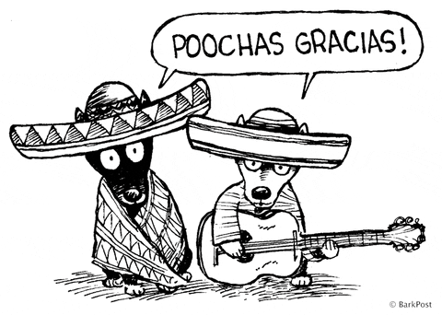
Thanks

